Slide 1
PSCS215- Subsidy Chain: Promising Transparency and Integrity in Government Fund Distribution
PIP2001 Capstone Project
VIVA-VOCE
Batch Number: CBC-09
Roll Number | Student Name
20211CBC0046 | DYAMALLI. K
20211CBC0049 | MONICA. N
20211CBC0039 | Y.HARSHITHA REDDY
20211CBC0061 | RUPALAGUDDI LIKHITHA
Under the Supervision of,
Ms. ARSHIYA LUBNA
Assistant Professor
School of Computer Science and Engineering
Presidency University
Name of the Program: COMPUTER SCIENCE AND ENGINEERING(BLOCKCHAIN)
Name of the HoD: DR. PRAVINTHA RAJA
Name of the Program Project Coordinator: SUMA GOWDA
Name of the School Project Coordinators: Dr. Sampath A K / Dr. Abdul Khadar A / Mr. Md Ziaur Rahman

Slide 2
Table of Contents
S.No Contents Pg.no
1. Introduction 3
2. Literature Review 4-8
3. Research Gaps Identified 9
4. Proposed Methodology 10
5. Objectives 11
6. Methodologies/Modules 12-14
7. Timeline of Project 15
8. Outcomes / results Obtained 16-21
9. Conclusion 22
10. References 23
11. Publication Details 24

Slide 3
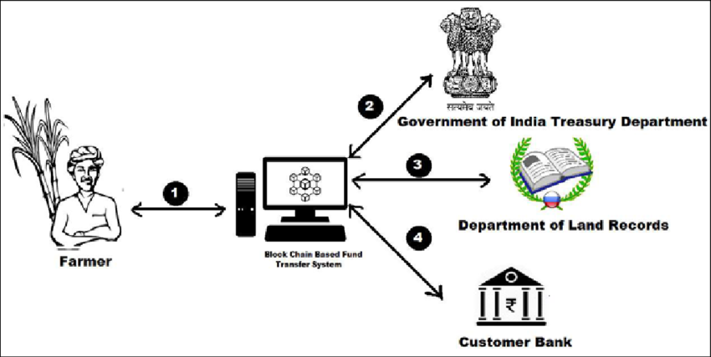
Introduction
Subsidy Chain leverages blockchain technology, using the Polygon network and Solidity smart contracts, to create a transparent, immutable tracking system for government subsidies. This DApp ensures that every step of subsidy distribution is recorded and accessible.
By automating verification processes, Subsidy Chain minimizes human error and fraud. Beneficiaries can track their subsidies, ensuring funds reach them as intended, thus enhancing trust and integrity in the system.

Slide 4
Literature Review
Blockchain technology has emerged as a groundbreaking innovation that addresses critical
inefficiencies in government subsidy management, ensuring transparency, security, and
accountability. Traditional subsidy systems often face significant challenges, including fraud,
mismanagement, and a lack of trust due to their reliance on centralized databases, manual
processes, and intermediaries. These limitations lead to delays, human errors, and potential
misuse of funds. Blockchain’s decentralized, transparent, and tamper-proof nature offers an
effective solution, transforming how subsidies are distributed and managed. The PM Kisan
Subsidy Chain is a pioneering initiative that leverages blockchain technology to optimize
subsidy management, ensuring equitable, efficient, and secure delivery of benefits to eligible
recipients.[1]

Slide 5
A core feature of blockchain technology is its immutable ledger, which ensures that once a
transaction is recorded, it cannot be altered or deleted. This immutability is particularly crucial in subsidy management, where the integrity of transaction data is essential to maintaining public trust. In the PM Kisan Subsidy Chain, every transaction, from the allocation of funds to the final disbursement to beneficiaries, is recorded transparently on the blockchain. This enables real-time verification by stakeholders, including government officials, auditors, and recipients, fostering a high level of accountability. By eliminating the possibility of tampering or unauthorized changes, blockchain ensures that subsidies reach their intended recipients without diversion or fraud.[2]

Slide 6
Automation plays a pivotal role in optimizing subsidy management, and smart contracts are at the heart of this process. Written in programming languages like Solidity, smart contracts are self-executing agreements that automate tasks based on predefined rules and conditions. For instance, in the PM Kisan Subsidy Chain, a smart contract can automatically verify a farmer’s eligibility criteria, such as landholding size, crop type, and income level, and trigger the disbursement of subsidies directly to their account. This eliminates the need for intermediaries, reducing delays, errors, and the risk of corruption. Smart contracts also enforce two key types of integrity: data integrity, which ensures that altering transaction data requires network consensus, and rule integrity, which prevents manipulation of the contract’s logic.[3]

Slide 7
1.Blockchain Technology and Transparency:
There are several studies that indicate blockchain technology increases transparency in supply chains. For instance, it has been proven that blockchain's decentralized and immutable nature ensures that every transaction is logged and is visible to the authorized stakeholders. This transparency also minimizes cases of corruption and fraud in any governmental process. A case of Walmart's food safety tracking through the use of blockchain indicated that blockchain minimized time taken to trace the origin of a product to 2.2 seconds instead of 7 days (IBM Food Trust, 2019). This might transform the functioning of government regulation systems.

Slide 8
2. Smart Contracts for Automated Regulation:
Smart contracts, an integral part of blockchain technology, have been explored as tools to automate compliance and reporting. Research by Christidis and Devetsikiotis (2016) explained how smart contracts could enforce regulations automatically, such as ensuring that imported goods meet quality standards before clearance. Governments can benefit from reduced manual intervention and faster enforcement of rules.
3. Anti-Counterfeiting Systems in Supply Chain:
A blockchain-based tracking system ensures the authenticity of products since it provides digital records that cannot be altered and enables governments to check the originality and the difference in time. This application is very useful for drugs, luxury commodities, and electronic products.

Slide 9
RESEARCH GAPS IDENTIFIED
The current methods of government subsidy distribution predominantly rely on traditional approaches.
Centralized Databases
Manual Processing
Lack of Traceability
Limited Beneficiary Engagement
Inflexibility to Adapt
High Administrative Costs

Slide 10
Proposed Methodology
Automation: Smart contracts handle fund release based on predefined conditions, reducing manual intervention.
Transparency: All transactions are recorded on the blockchain, ensuring public verifiability and accountability.
Real-Time Monitoring: Dashboards track programs, and beneficiaries receive instant notifications about their applications.
Security: Uses encryption for transaction security while maintaining privacy for sensitive data.

Slide 11
Objectives
1. System Architecture
Components:
Government Agencies: Initiate and record disbursements.
Smart Contracts: Automate rules on the Polygon blockchain.
Beneficiaries: Users tracking fund status via DApp.
2. Workflow
Phase 1: Agencies create subsidy programs; beneficiaries apply with verified credentials.
Phase 2: Approved programs deploy smart contracts with eligibility criteria.
Phase 3: Funds are

Slide 12
Methodology/Modules
The Subsidy Chain project includes key modules to ensure secure and transparent subsidy distribution:
1.Government Registration: Allows government agencies to register subsidy programs and store them on the blockchain for transparency.
2.Beneficiary Registration: Verifies and registers eligible beneficiaries using government databases, securing their data on the blockchain.
3.Smart Contract Management: Automates subsidy distribution with predefined rules, reducing delays and corruption.
4. Subsidy Disbursement: Transfers funds securely through the blockchain, making all transactions traceable.
5. Fund Tracking: Beneficiaries can track the status of their subsidies in real-time.
6. Data Integrity: Keeps data secure and tamper-proof using blockchain encryption.
7. Corruption Detection: Monitors for suspicious activities and reports issues to prevent fraud.

Slide 13
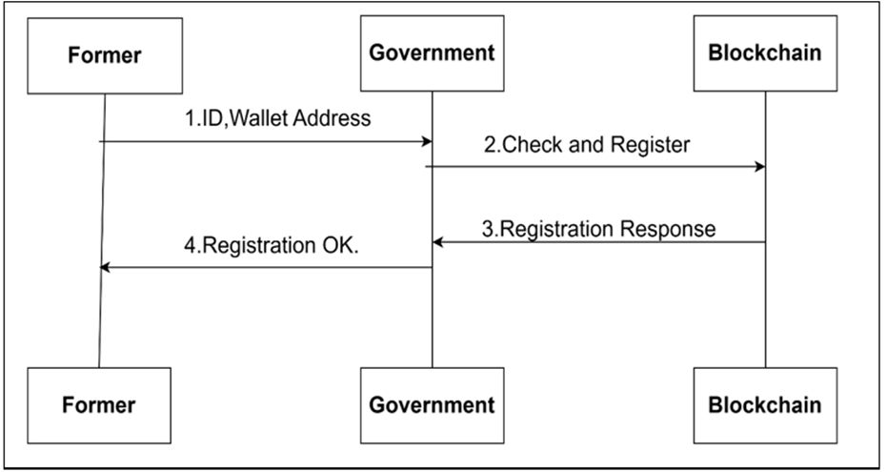
Entities and Their Roles:
Farmer: Submits subsidy applications and tracks claim status.
Government: Verifies eligibility, approves, and disburses subsidies.
Blockchain: Records transactions securely and automates the process through smart contracts

Slide 14
Interaction Flow
Farmer → Government: Farmers submit applications with eligibility and identity details.
Government → Blockchain: Government verifies and approves, triggering subsidy disbursement via smart contracts.
Blockchain → Farmer: Farmers receive confirmation and can verify transactions on the blockchain.
Farmer → Blockchain: Farmers check transaction details and report issues if needed.
Government → Blockchain: Government audits blockchain records for transparency and accuracy.

Slide 15
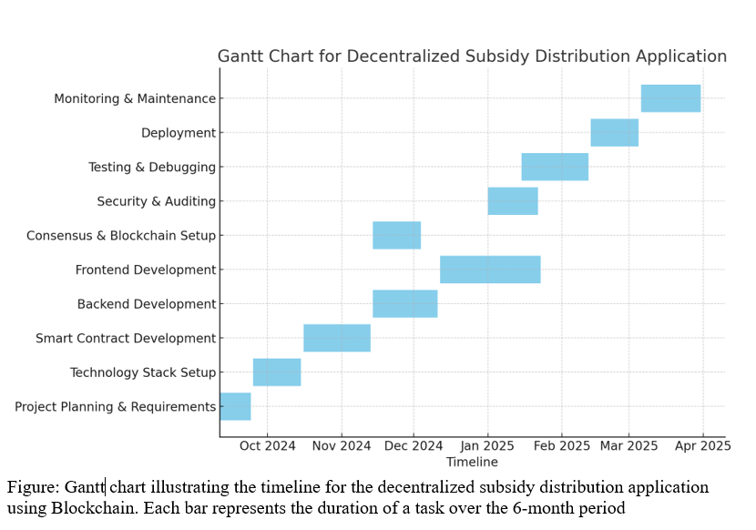
Timeline of Project

Slide 16
Outcomes/Results Obtained
More Transparency
Better Accountability
Easier Access for Beneficiaries
Less Fraud:
Real-time Monitoring
Secure Data

Slide 17
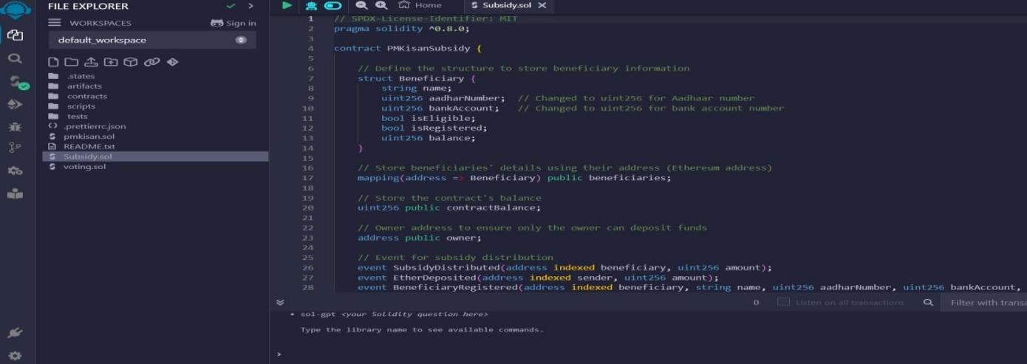

Slide 18
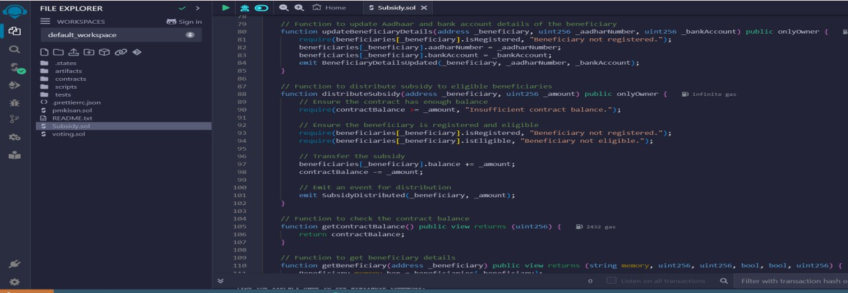

Slide 19
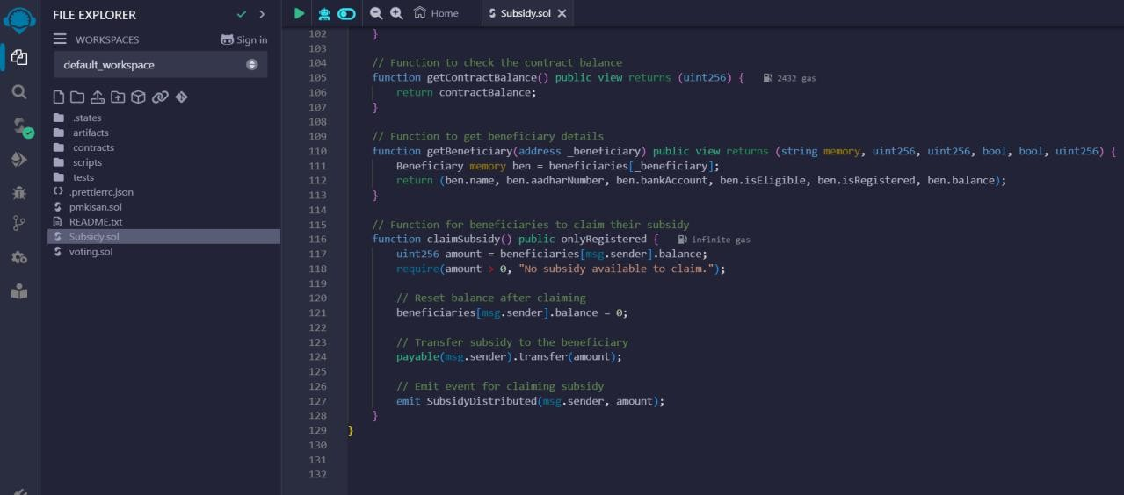

Slide 20
Using remix ide platform we need to a run solidity code for blockchain for the government to be able to track the origin and destination of product, To deploy a backend solidity code we need to connect to meta mask wallet and it should be there transaction fees in the wallet to deploy the code ,After deploying the code it will generate the ABI and Contract address
After deploying code and connecting to the meta mask we get the transaction confirmation from the meta mask wallet, after we will get the all transaction details in remix ide platform

Slide 21
It will displays all the transaction details in the remix ide platform
The blockchain system successfully recorded all stages of the product lifecycle, from raw material sourcing to final delivery. Each transaction was timestamped and immutable, ensuring complete traceability. Stakeholders, including government agencies, gained real-time visibility into the supply chain.

Slide 22
Conclusion
The Subsidy Chain project uses blockchain to create a transparent, secure, and efficient subsidy distribution system.
By automating processes through smart contracts, it eliminates corruption, minimizes delays, and ensures timely delivery of funds to beneficiaries.
The platform allows real-time tracking of payments, enhances accountability, and fosters trust in the government’s subsidy programs, ultimately leading to a more fair and efficient distribution process for all parties involved.

Slide 23
References
Z. Zheng et al., "Blockchain Technology: Applications and Use Cases," Journal of Industrial Information Integration, vol. 10, pp. 22-28, 2018.
M. A. Alharbi et al., "Blockchain in Public Sector Services: An Empirical Analysis," International Journal of Information Management, vol. 52, pp. 102-113, 2020.
N. Kshetri, "Can Blockchain Strengthen the Global Economy?" Journal of Business Research, vol. 70, pp. 228-234, 2017.
P. Treleaven et al., "Blockchain Technology in Finance: A New Paradigm," Computer and Telecommunications Law Review, vol. 23, no. 4, pp. 120-126, 2017.
A. Omar et al., "Smart Contracts for Subsidy Distribution: A Case Study in Agricultural Finance," Sustainability, vol. 13, no. 8, pp. 4230, 2021.

Slide 24
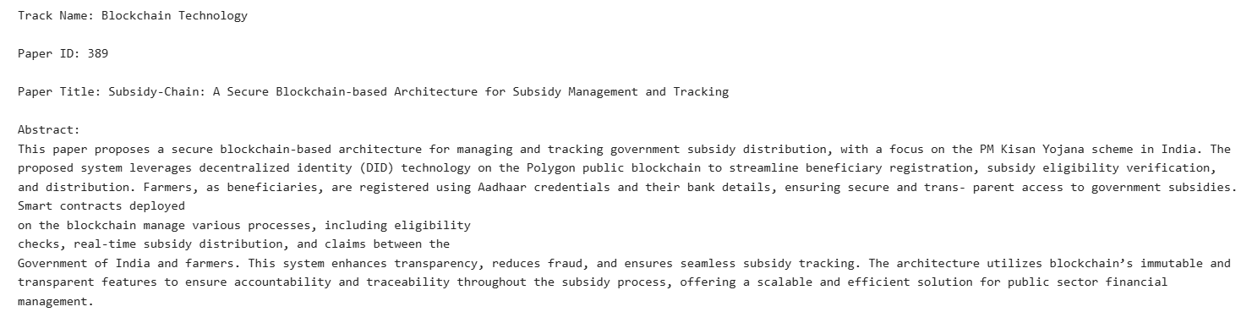
Publication Details

Slide 25


